Slide 1
Man’s Best Friend
Dogs

Slide 2
Why
Increase your mood dramatically
Improves your physical wellbeing and encourages a healthy fitness routine.
Increase social interactions
There’s never a dull or boring moment.
Health benefits

Slide 3
Learning from dogs
Behavior
Personality
Attitude
Flexible
The willingness to provide their family members with unconditional `
` love
loyalty
companionship down to their very last breath.

Slide 4

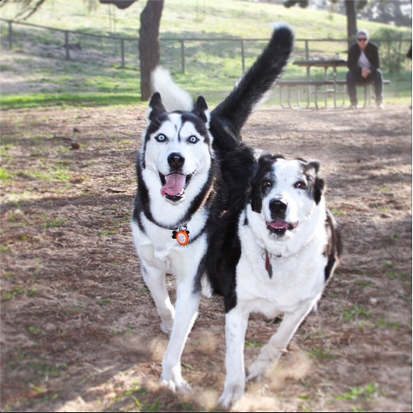
Behaviour
No worries
Live in the moment
Cherish every momenr

Slide 5
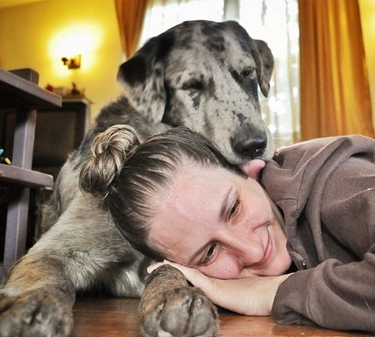
Pure Love
No Expenses
Nothing in return

Slide 6
Don't hold grudges

Slide 7
Flexible

Slide 8
Love and Loyality
contribute more to your job,

Slide 9
Thank You

